Slide 1
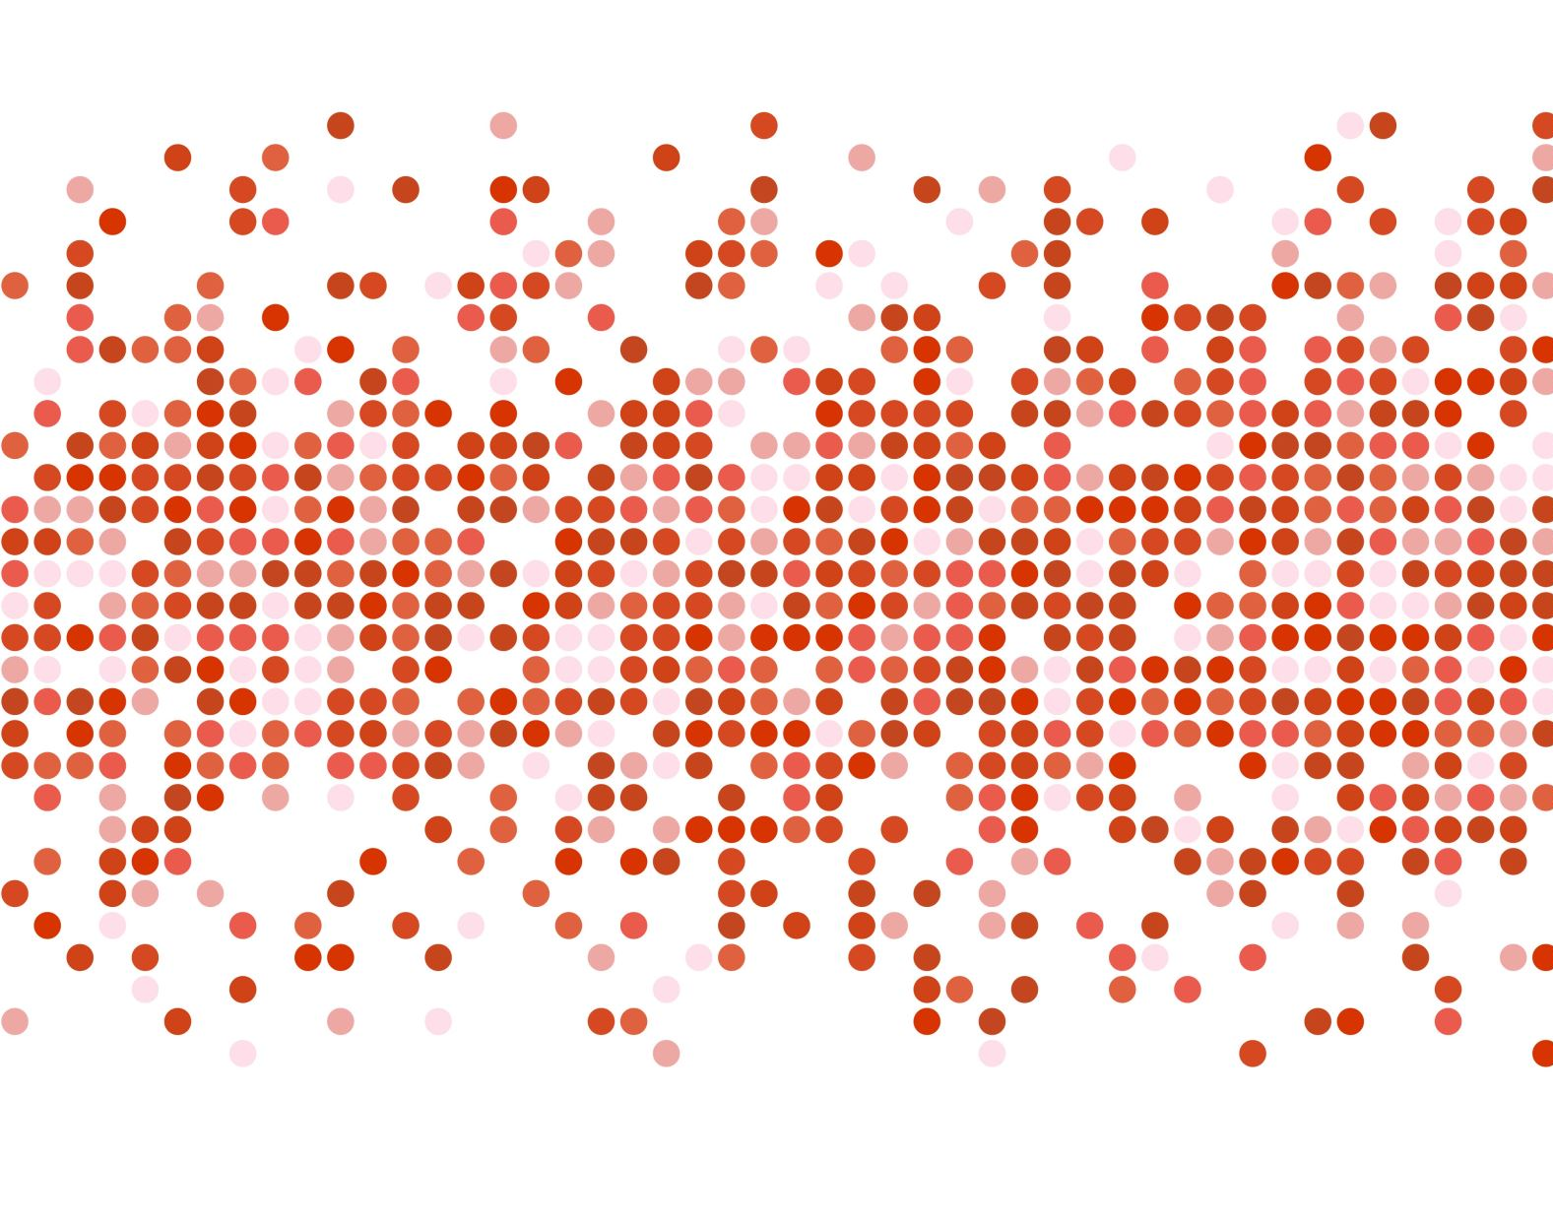

Heart disease indicators
Rehab alsawad

Slide 2
Outlines
Introduction
The Dataset
The Model &results
Conclusion
Data cleaning & pre-processing

Slide 3
Introduction
Cardiovascular diseases (CVDs), including heart attacks and strokes, are the number-one cause of deaths globally
They are the cause of 17.3 million deaths annually, and this number can be increased. By 2030, almost 23 million people will die from CVDs, mainly from heart disease and stroke, unless effective interventions are taken

Slide 4
The Centers for Disease Control and Prevention has identified high blood pressure, high blood cholesterol, and smoking as three key risk factors for heart disease.
The National Heart, Lung, and Blood Institute highlights a wider array of factors such as Age, Environment and Occupation, Family History
Diagnosis tends to be driven by an initial survey of these common risk factors followed by bloodwork and other tests.

Slide 5
Data collection
The Behavioral Risk Factor Surveillance System (BRFSS) is a health-related telephone survey that is collected annually by the CDC.
Each year, the survey collects responses from over 400,000 on health-related risk behaviors, chronic health conditions, and the use of preventative services.
Most questions on the core BRFSS instrument were at least moderately reliable and valid,

Slide 6
Limitations
The interview may take 20-30 mins
low response rate
Incomplete entries
subject to recall bias and social desirability bias

Slide 7
Dataset

Slide 8
Dataset
This dataset contains survey responses from cleaned BRFSS to be used binary classification of heart disease.

Slide 9
The question to be explored is:
To what extend can survey responses from the BRFSS be used for predicting heart disease risk?
Can a subset of questions from the BRFSS be used for preventative health screening for diseases like heart disease?

Slide 10
Learning & problem type | Supervised binary classification
Target | Heart disease (“yes”, “no”)
Number of features | 18
Number of instances | 319795
Objective | use attributes to predict the presence of heart disease

Slide 11
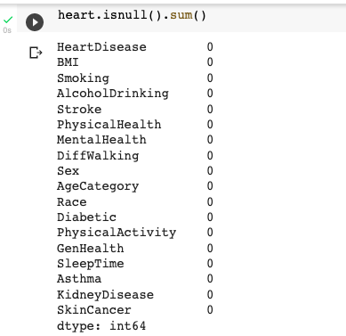
Data cleaning & pre-processing
Feature selection :unnecessary variables removed
Recoding variable names and values so that they are meaningful and more interpretable.
No missing value

Slide 12

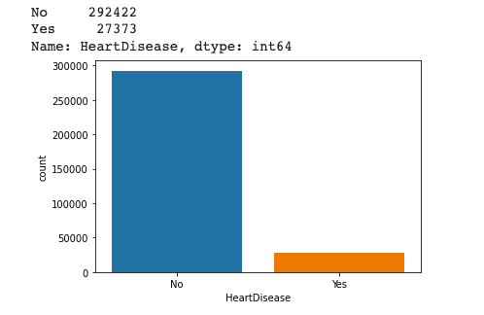
Imbalanced Target

Slide 13
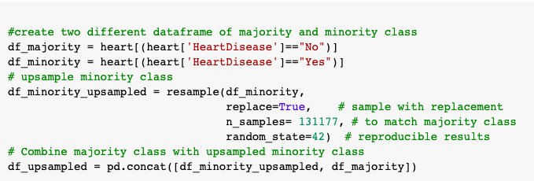
Upsampling
Notes:
To overcome this issue or upsampling refers to the technique to create artificial or duplicate data points or of the minority class sample to balance the class label.

Slide 14

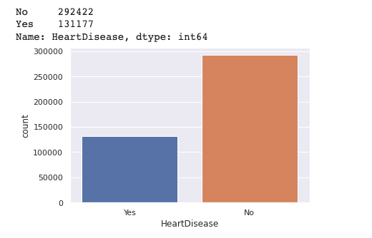

Slide 15
ML modeling process

Slide 16
Data splitting
Model
Validation

Slide 17
Random forest classifier
Logistic regression
Notes:
Supervised , trained with bagging methods
Based on the number of using decision tree each one will give you result then we take taking

Slide 18
Data splitting
Training
Testing
Validation
80%
20%
Notes:
Training giving the large perctange to train the data set , the sample of the data used to fit the modle
The model will be trained from this data
Validation : is used to evaluate the model evaluate the parameters
Testing : the sample of the data that used to to provide an evaluation of final model

Slide 19
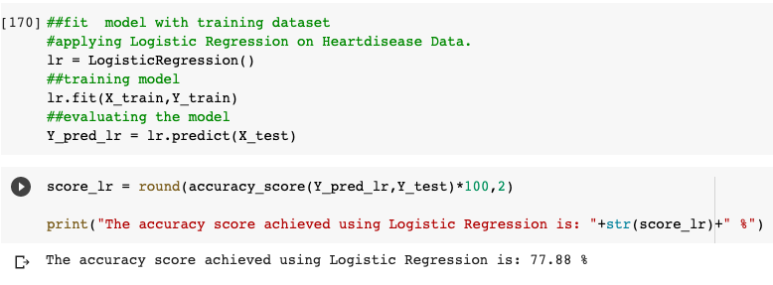
Logistic Regression

Slide 20
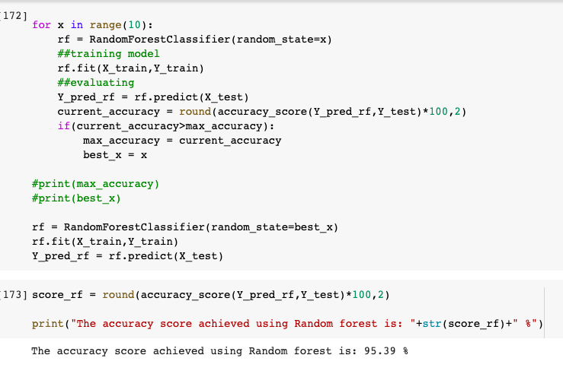
Random forest classifier

Slide 21
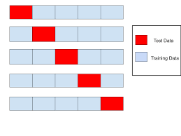
Cross validation
K-fold cross-validation
The process is repeated for 5 k folds times until each group is treated as validation and remain as training data .
Each iteration one group is selected as validation and the remain.
Notes:
It is resampling procuder used to evaluate the model and assess how the model will perfume

Slide 22
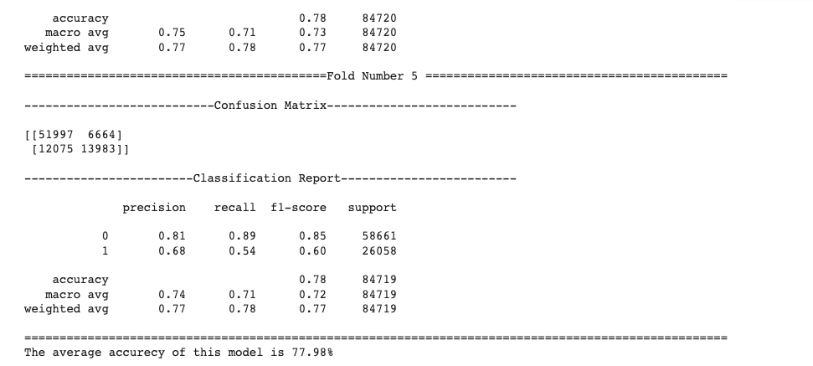
Logistic Regression-cross validation
Notes:
The final accuracy of the model is computed by taking the mean accuracy of the K-models validation data
Classification report importance here :
Precision :
F1 score

Slide 23
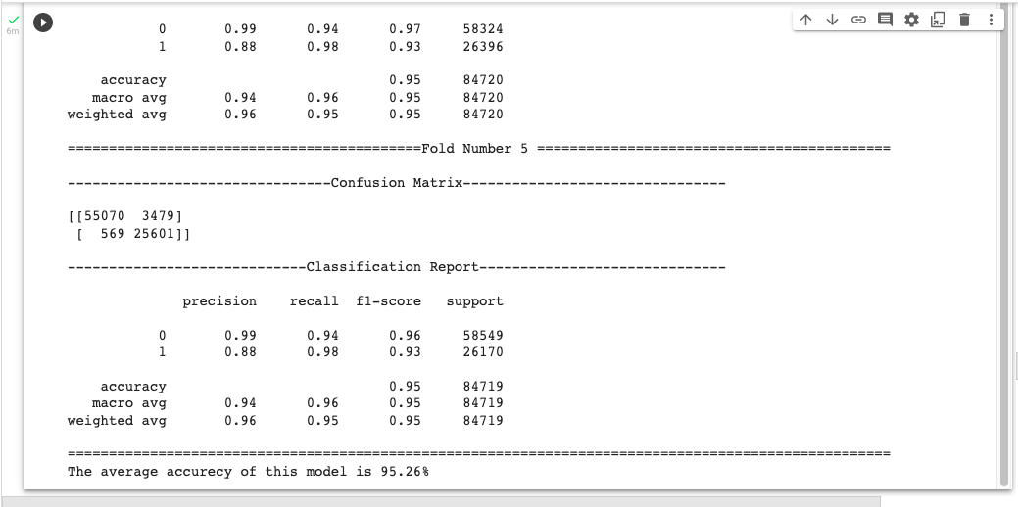
Random forest classifier –cross valdation
Notes:
The final accuracy of the model is computed by taking the mean accuracy of the K-models validation data

Slide 24
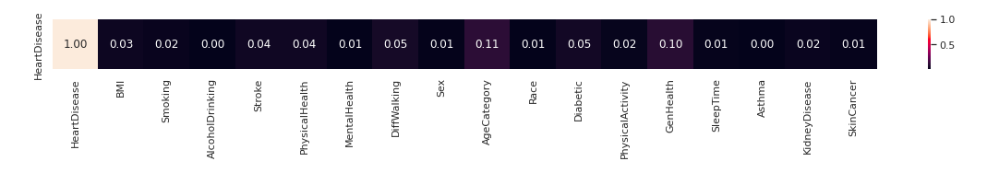

Slide 25
Conclusion
The two models were trained and tested with maximum score as following The random forest is best performing comparing to the logistic regression.
Logistic Regression | Random Forest
77.3 | 95.39%

Slide 26
Conclusion
The most feature has impact on the target are : Age category, general health , diabetic
Answering Early prediction of heart disease can be done , help in taking preventive measures the cost of medication will be minimized
Accuracy rate will be high

Slide 27
Future work
Develop Risk Score Cardiac Risk Assessment by using DL

Slide 28
References
https://www.ncbi.nlm.nih.gov/pmc/articles/PMC5623029/
https://www.moh.gov.sa/en/Ministry/MediaCenter/News/Pages/News-2013-10-30-002.aspx

Slide 29
Thank you Any questions?

